Slide 1
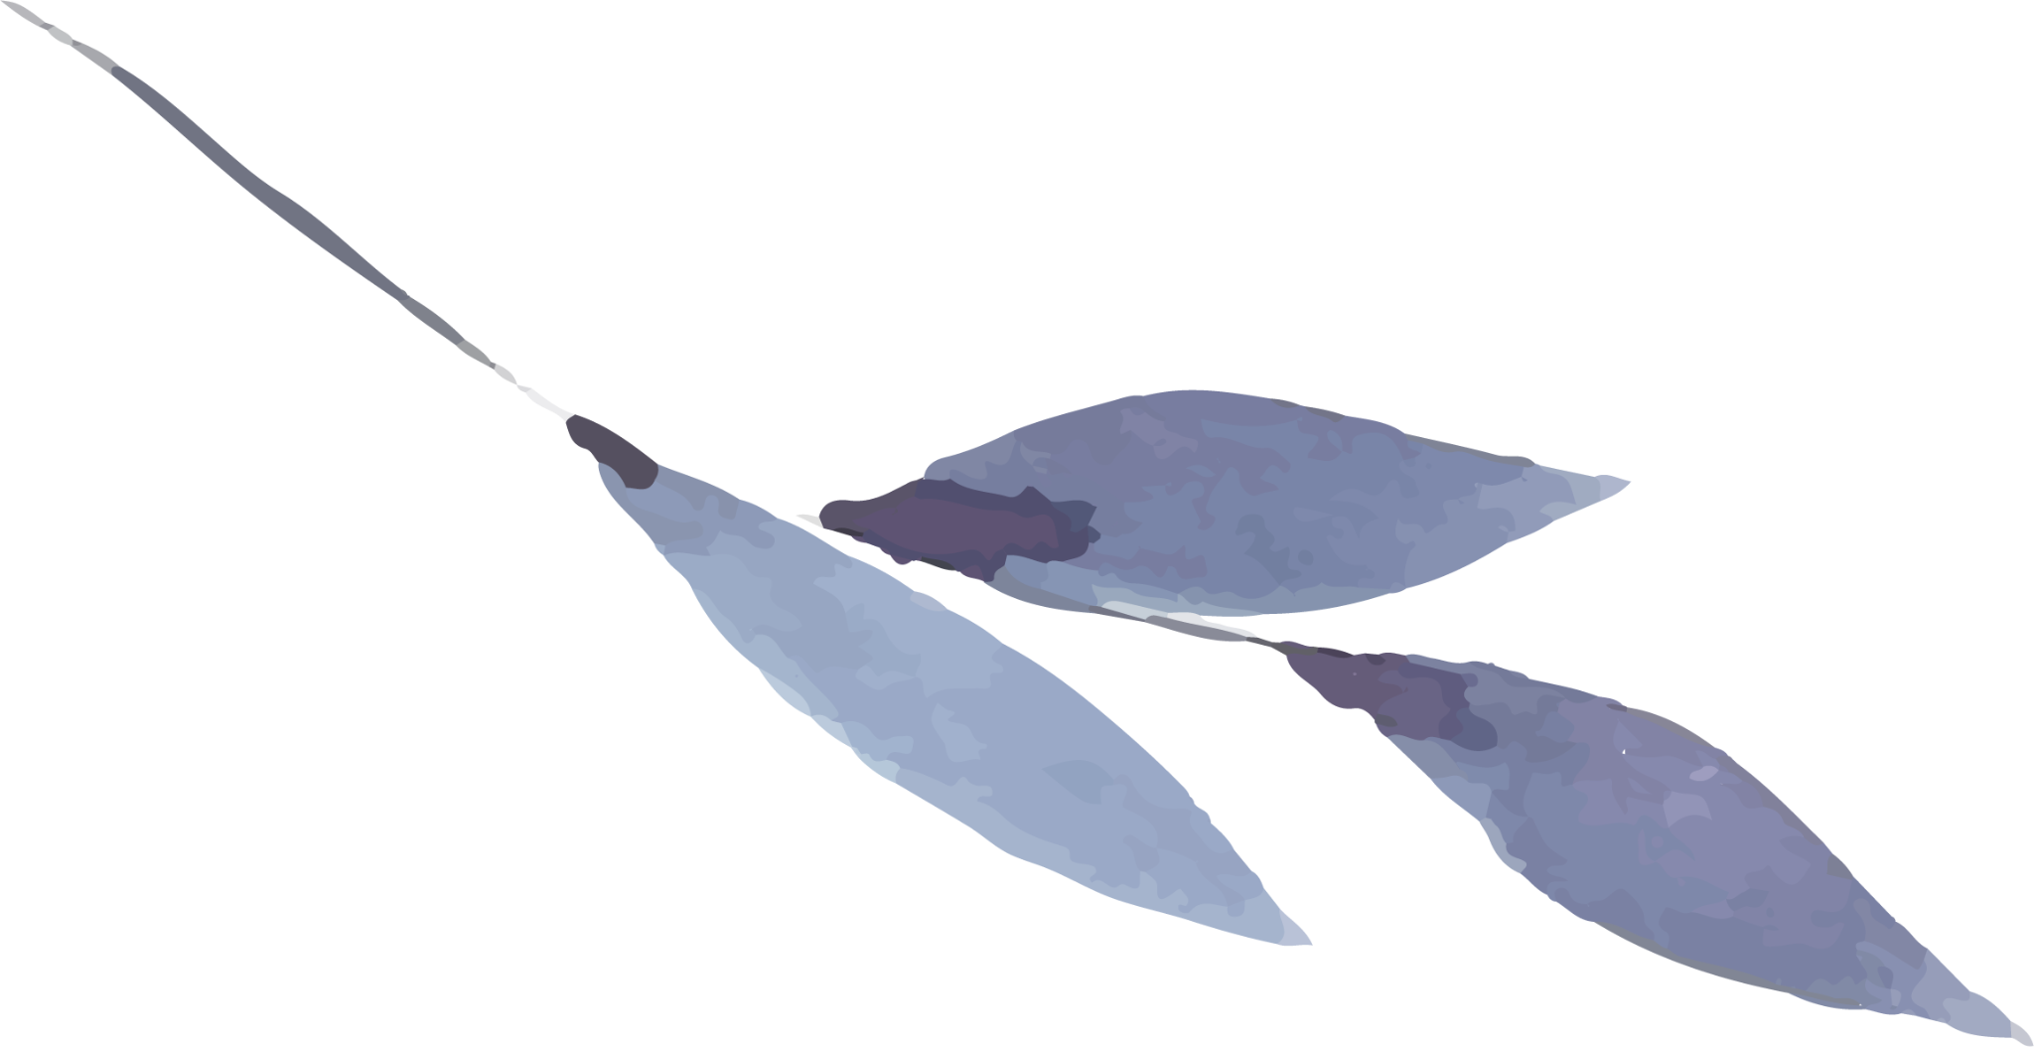



CHRISTIANITY
Belicks A
245202107
I M.A English

Slide 2
What Is Christianity?

Slide 3
Table of contents
01
02
03
04
Name of the section
Name of the section
You can describe the topic of the section here
You can describe the topic of the section here
Name of the section
Name of the section
You can describe the topic of the section here
You can describe the topic of the section here

Slide 4
Introduction
Mercury is the closest planet to the Sun and the smallest one in the entire Solar System. This planet’s name has nothing to do with the liquid metal, since Mercury was named after the Roman messenger god. Despite being closer to the Sun than Venus, its temperatures aren’t as terribly hot as that planet’s. Its surface is quite similar to that of Earth's Moon, which means there are a lot of craters and plains
Speaking of craters, many of them were named after artists or authors who made significant contributions to their respective fields. Mercury takes a little more than 58 days to complete its rotation, so try to imagine how long days must be there! Since the temperatures are so extreme, albeit not as extreme as on Venus, and the solar radiation is so high, Mercury has been deemed to be non-habitable for humans

Slide 5
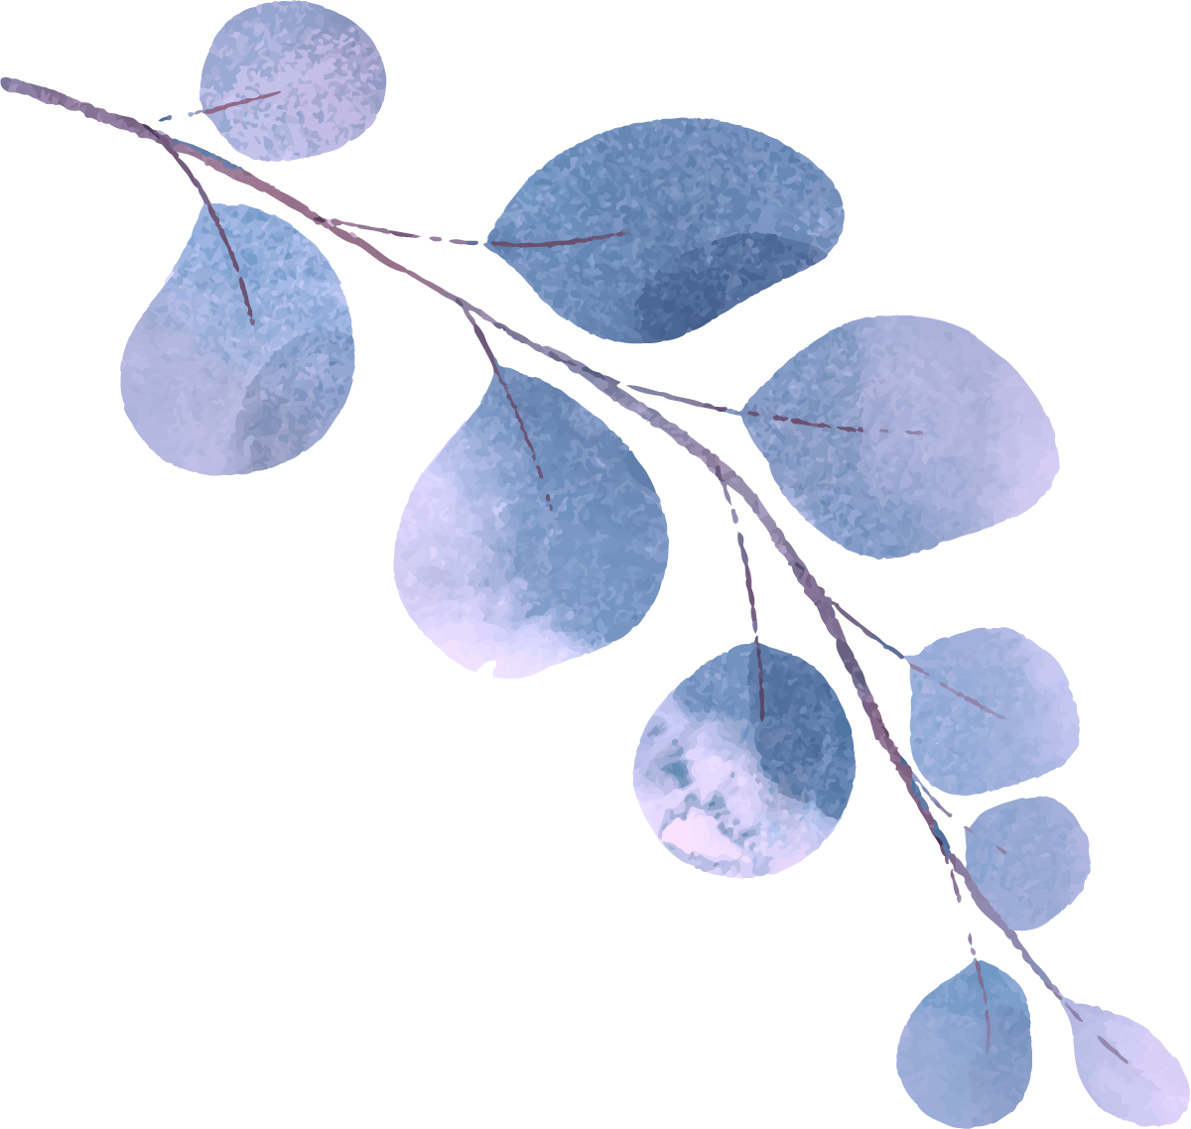

01
Name of the section
You can enter a subtitle here if you need it

Slide 6
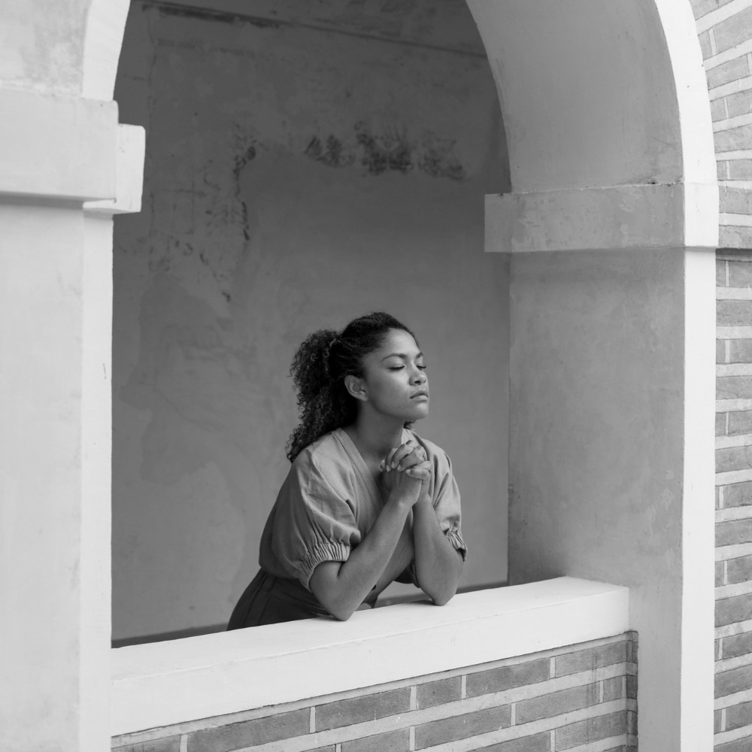
The slide title goes here!
Do you know what helps you make your point clear? Lists like this one:
They’re simple
You can organize your ideas clearly
You’ll never forget to buy milk!
You can replace the image. Just right-click on it and select “Replace image”

Slide 7
Two ideas
Mercury
Venus
Mercury is the closest planet to the Sun and the smallest one in the Solar System. This planet’s name has nothing to do with the liquid metal
Venus has a beautiful name and is the second planet from the Sun. It’s hot and is the second-brightest natural object in the night sky

Slide 8
Three ideas
Mercury
Mercury is the closest planet to the Sun and the smallest one in the Solar System
Mars
Despite being red, Mars is actually a cold place. It’s full of iron oxide dust
Venus
Venus has a beautiful name and is the second planet from the Sun

Slide 9
Six different ideas
Mercury
Venus
Mars
Mercury is the smallest planet in the Solar System
Venus is the second planet from the Sun
Despite being red, Mars is actually a cold place
Jupiter
Saturn
Neptune
Jupiter is the biggest planet in the Solar System
Saturn is composed of hydrogen and helium
Neptune is the farthest planet from the Sun

Slide 10
Awesome words

Slide 11
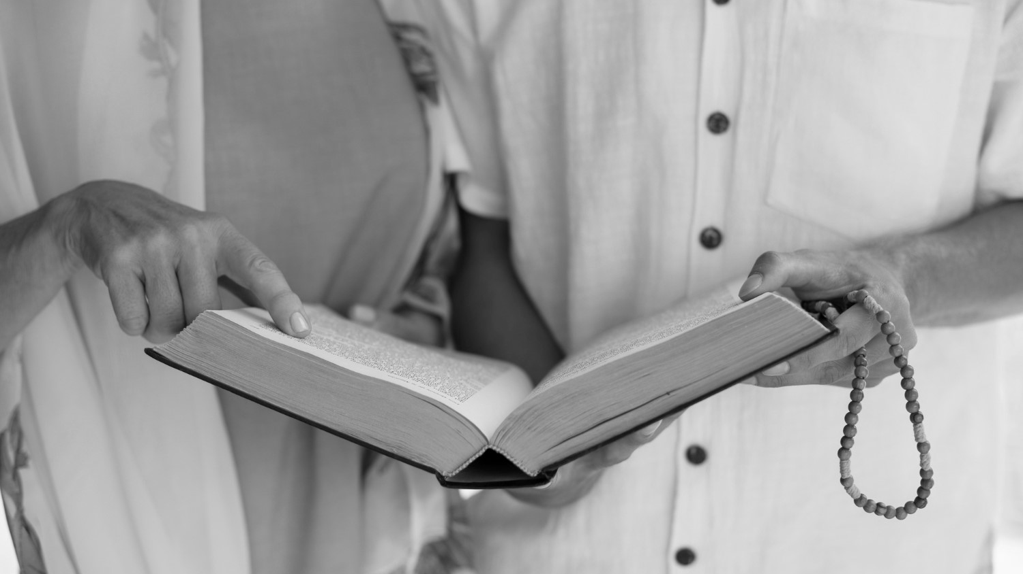
A picture is worth a thousand words

Slide 12

Product demo
You can replace the image on the screen with your own work. Just right-click on it and select “Replace image”

Slide 13
This is a map
Mercury
Venus
Mercury is the closest planet to the Sun
Venus is the second planet from the Sun

Slide 14
Our history
2XXX
Venus
2XXX
Saturn
Venus is the second planet from the Sun
Saturn is composed of hydrogen and helium
2XXX
Mars
2XXX
Neptune
Despite being red, Mars is actually a cold place
Neptune is the farthest planet from the Sun

Slide 15
You can use an infographic
Mars
Venus
Saturn
Jupiter
Despite being red, Mars is actually a cold place
Venus is the second planet from the Sun
Saturn is composed of hydrogen and helium
Jupiter is the biggest planet of them all

Slide 16
This is a table
Year | Venus | Mars
20XX | $0.30 | $31.90
20XX | $3.90 | $15.40
20XX | $157.30 | $492.80
20XX | $3,368.20 | $13,929.80

Slide 17
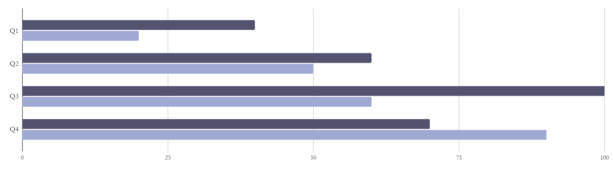
This is a graph
Mars
Neptune
Despite being red, Mars is actually a cold place
Neptune is the farthest planet from the Sun
Follow the link in the graph to modify its data and then paste the new one here. For more info, click here

Slide 18
21 million
Big numbers catch your audience’s attention

Slide 19
333,000
386,000 km
The Sun’s mass compared to Earth’s
Distance between Earth and the Moon

Slide 20
Thanks!
Do you have any questions?
youremail@freepik.com
+34 654 321 432
yourwebsite.com
Please keep this slide for attribution

Slide 21

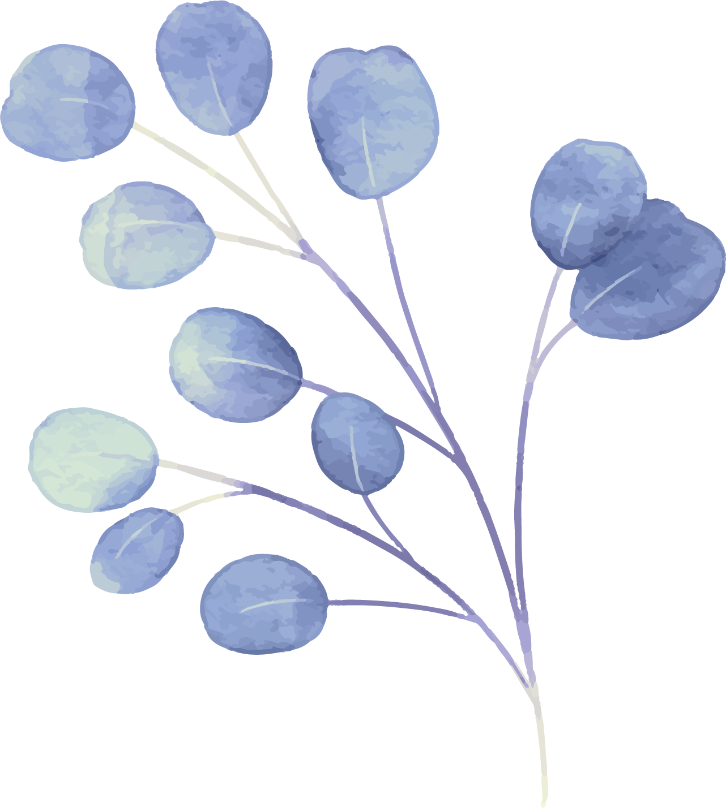


Alternative resources
Here’s an assortment of alternative resources whose style fits that of this template:
Illustrations
Ash wednesday celebration poster template
Ash wednesday celebration facebook template

Slide 22
Resources
Did you like the resources used in this template? Get them on these websites:
Illustrations
Ash wednesday celebration invitation template
Ash wednesday celebration poster template
Ash wednesday celebration facebook template
Photos
Front view people praying together
Medium shot young woman praying

Slide 23
Instructions for use
If you have a free account, in order to use this template, you must credit Slidesgo by keeping the Thanks slide
As a Free user, you are allowed to:
Modify this template
Use it for both personal and commercial projects
You are not allowed to:
Sublicense, sell or rent any of Slidesgo Content
Distribute Slidesgo Content unless it has been expressly authorized by Slidesgo
Include Slidesgo Content in an online or offline database or file
Offer Slidesgo templates (or modified versions of Slidesgo templates) for download
Acquire the copyright of
Slidesgo Content
For more information about editing slides, please read our FAQs or visit our blog

Slide 24
Instructions for use (premium users)
As a Premium user, you can use this template without attributing Slidesgo or keeping the Thanks slide
You are allowed to:
Modify this template
Use it for both personal and commercial projects
Share this template in an
editable format
Hide or delete the “Thanks” slide and the mention to Slidesgo in the credits
You are not allowed to:
Sublicense, sell or rent any of Slidesgo Content
Distribute Slidesgo Content unless it has been expressly authorized by Slidesgo
Use any of the elements that are part in a separated way
Register any of the elements as a trademark or logo in an intellectual property registry
For more information about editing slides, please read our FAQs or visit our blog

Slide 25
Fonts
Colors
This presentation has been made using the following fonts:
All the colors used in this presentation
Click on the button of the link to the fonts
#313133
#ffffff
#53526F
Gentium Book Plus
#f2e4f1
#c6cce7
#d4dedc
Asap
To view this template correctly in PowerPoint, download and install the fonts we used
#a0a9d1
#dad6f0

Slide 26
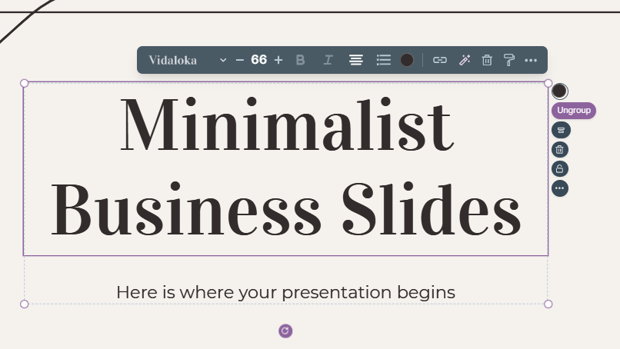
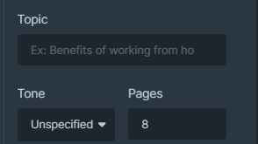
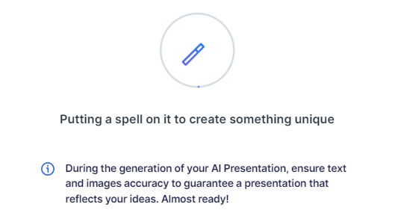
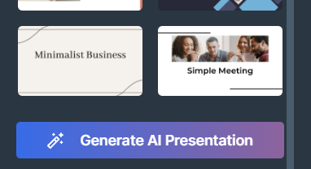
Presentation Maker
Slidesgo introduces its latest feature: the Presentation Maker. Enjoy two main functionalities - firstly, with a few clicks, create marvelous presentations with Artificial Intelligence that adapt to your needs. And it's completely free!
The second functionality of this tool is that you can edit presentations through the online editor. Create interactive resources easily, quickly and without the need for any software. Change everything or start from scratch
Generate AI Presentation
Edit online

Slide 27
Use our editable graphic resources...
You can easily resize these resources without losing quality. To change the color, just ungroup the resource and click on the object you want to change. You can also look for more infographics on Slidesgo

Slide 30
 | Jan | Feb | Mar | Apr | Jun
Task 1
Task 2
Task 3
 | No | Yes | Yes | No | Yes
 | Yes | No | Yes | No | Yes
 | Yes | Yes | No | Yes | No
 | Jan | Feb | Mar | Apr | Jun
Task 1
Task 2
Task 3

Slide 32
6/10 | 8/10 | 7/10 | 4/10

Slide 33
...and our sets of editable icons
You can resize these icons without losing quality
You can change the stroke and fill color; just select the icon and click on the paint bucket/pen
In Google Slides, you can also use Flaticon’s extension, allowing you to customize and add even more icons

Slide 34
Educational icons
Medical icons

Slide 35
Business icons
Teamwork icons

Slide 36
Help & support icons
Avatar icons

Slide 37
Creative process icons
Performing arts icons

Slide 38
Nature icons

Slide 39
SEO & marketing icons

Slide 40
Premium infographics
Mercury
Mars
Venus
Mercury is the closest planet to the Sun and smallest one
Despite being red, Mars is actually a very cold place
The Solar System
2xxx
2xxx
2xxx
2xxx
2xxx
Venus is the second planet from the Sun and is terribly hot
Jupiter is a gas giant and the biggest planet in the Solar System
Saturn is a gas giant and has several and beautiful rings
Earth
Jupiter
Saturn

Slide 41
Premium infographics
75%
15%
Mars is very cold
30%
Jupiter is a gas giant
Mercury
Mercury is the closest planet to the Sun and the smallest of them all
75%
30%
Saturn has rings

Slide 42
Premium icons
Digital marketing

Slide 43
Premium icons
Online learning

Slide 44
Premium icons
Laboratory

Slide 45
Premium icons
Goals & results

Slide 46
Premium icons
Infographic elements

Slide 47


